Slide 1
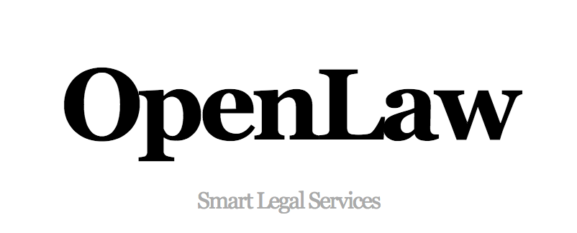
“Building Dynamic, Next Generation Legal Agreements”
CONFIDENTIAL © 2017 Aaron Wright, David Roon

Slide 2
SUMMARY
Big Opportunity: First mover in potential $139 billion transactional legal market.
Strong Team: Top legal academic and blockchain-engineer, who have a deep understanding of the legal/financial markets and who have built scalable Internet-based products
Sustainable Technological Advantage: Through a community-driven network-based approach, OpenLaw will become the go-to destination for lawyers to assemble and build next generation legal contracts
Need support: To finalize development of innovative “open legal protocol” that underpins Open Law
CONFIDENTIAL © 2017 Aaron Wright, David Roon

Slide 3
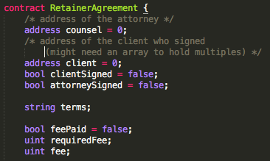
PROBLEM
Contracts Are Changing: It is now possible to model all or parts of legal agreements using code (smart contracts), decreasing the cost and friction of creating, securing, and generating binding legal agreements.
No Comprehensive Tool: Lawyers lack basic tools to build these dynamic, “smart” contracts in a way that is enforceable and understandable to a legal professional.
CONFIDENTIAL © 2017 Aaron Wright, David Roon

Slide 4
SOLUTION: OPEN LAW
SMART ENFORCEABLE, LEGAL AGREEMENTS
DECENTRALIZED STORAGE (ETHEREUM, SWARM, IPFS)
SMART CONTRACT TEMPLATES
OPEN LAW PROTOCOL
LEGAL MARKUP
LEGAL MARKDOWN
NETWORK- DRIVEN APPROACH
CONFIDENTIAL © 2017 Aaron Wright, David Roon

Slide 5
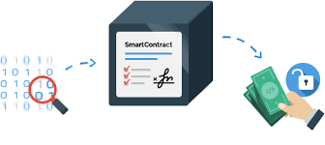
WHY NOW?
CONFIDENTIAL © 2017 Aaron Wright, David Roon

Slide 6
MARKET SIZE
Estimated
Total Legal Market
$437 Billion
Transactional Legal Market
$139 Billion
As smart contract technology matures, it has the potential to impact the entire transactional legal marketplace due to the efficiencies created by blockchain technology
CONFIDENTIAL © 2017 Aaron Wright, David Roon

Slide 7
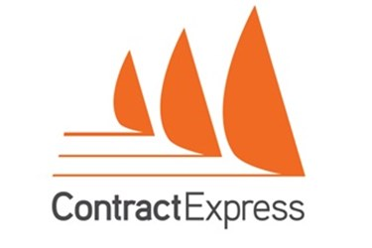
COMPETITION
Comprehensive Smart Contract Powered Agreements
Consumer Focused
Attorney Focused
Traditional Automated Agreements
CONFIDENTIAL © 2017 Aaron Wright, David Roon

Slide 8
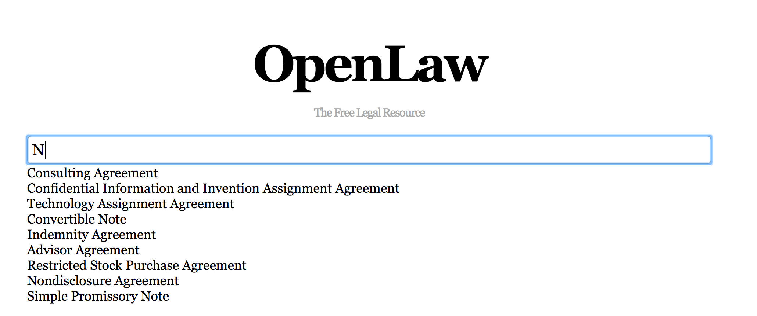
PRODUCT
CONFIDENTIAL © 2017 Aaron Wright, David Roon

Slide 9
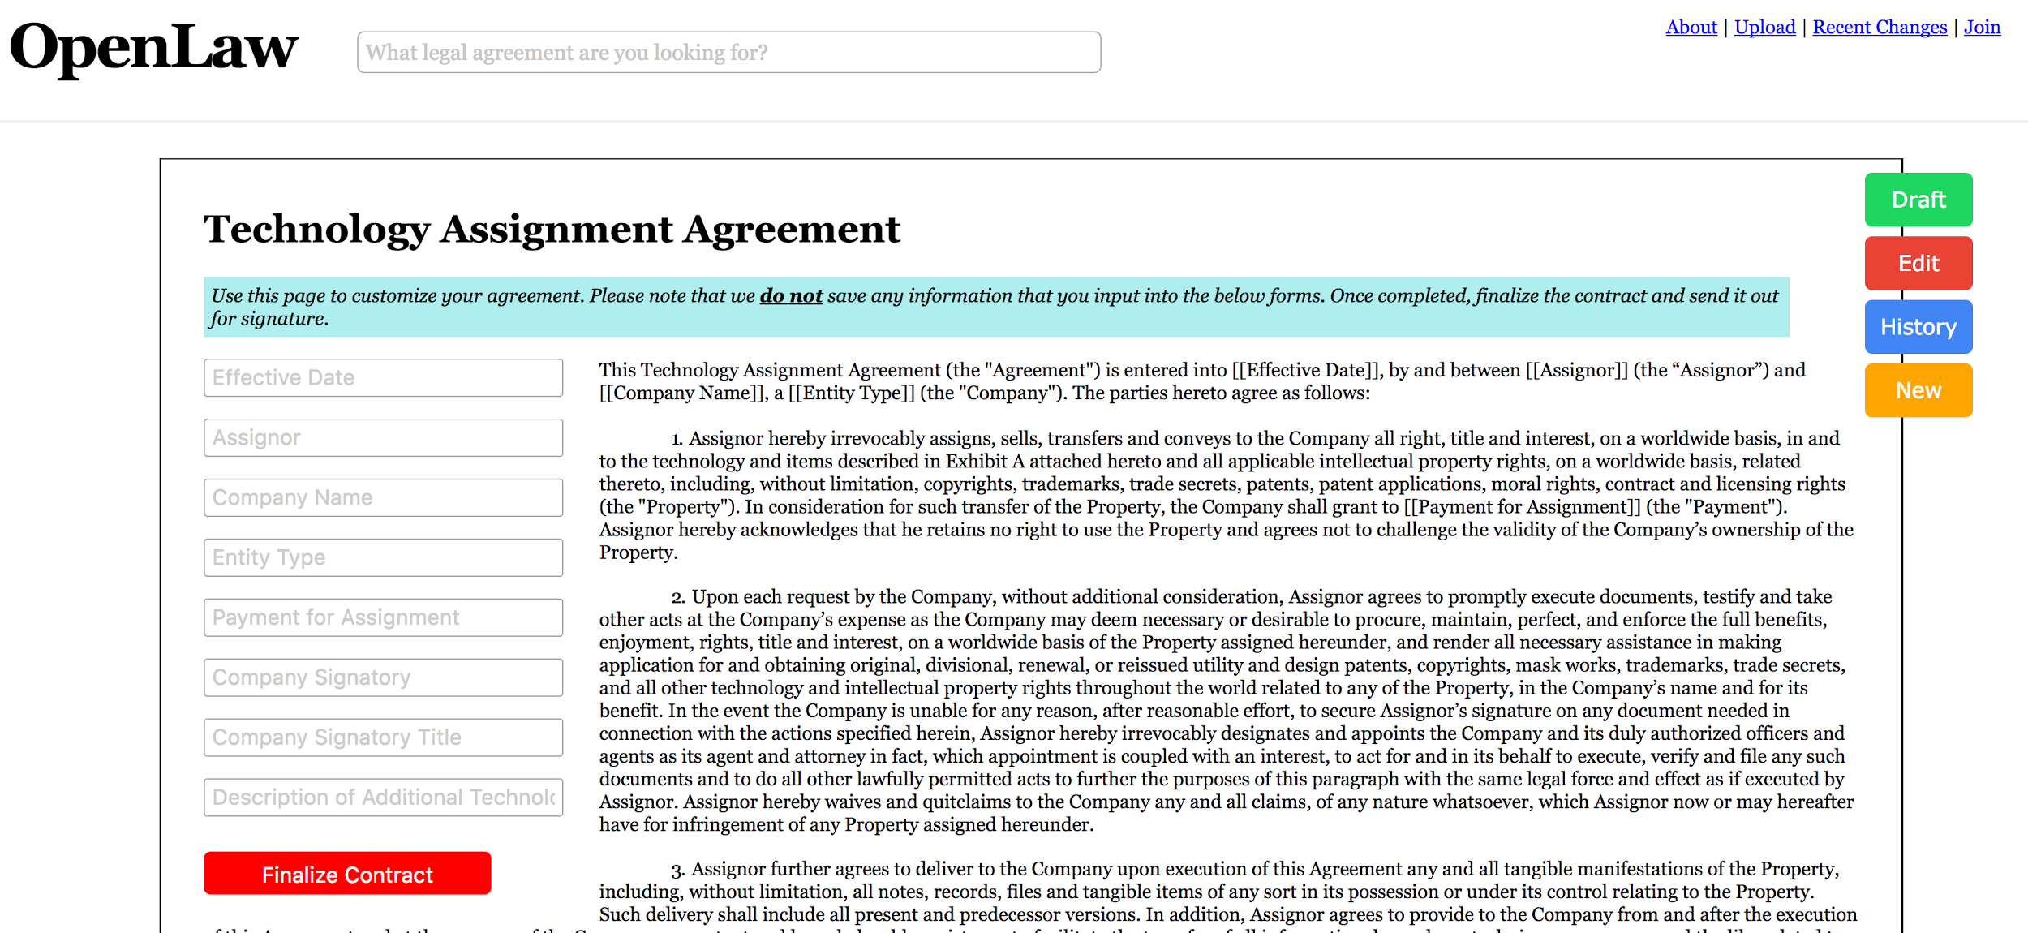
PRODUCT
CONFIDENTIAL © 2017 Aaron Wright, David Roon

Slide 10
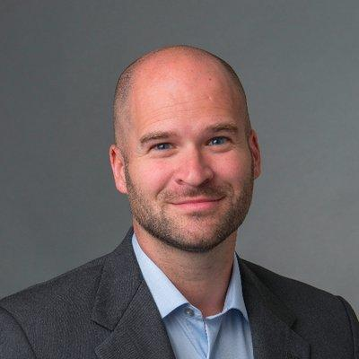
CORE TEAM
Professor at Cardozo Law School; Director of Cardozo’s Blockchain Project; former SVP product, business development, and general counsel at Wikia
Creator of JVM based tools to integrate Ethereum development; creator of Cubefriendly, an open data database engine; Technion (CS) ‘09
CONFIDENTIAL © 2017 Aaron Wright, David Roon

Slide 11
ROADMAP - PHASE 1
Markup language with variables and generated version in doc
Web UI to create the templates + to generate documents
Prototype of a marketplace for the templates
Search capability
Record contract object to a blockchain
Create basic legal templates
Outline scheme for API to record smart contract code
CONFIDENTIAL © 2017 Aaron Wright, David Roon

Slide 12
ROADMAP - PHASE 2 (Q3/Q4 2017)
Finalize API to record smart contract templates
Build system that enables parties to digitally sign contracts with hash (ensuring compliance with E-Sign / UETA)
Store template contract objects / executed agreements in IPFS/Swarm
Generate basic smart contract templates that can be included into agreements (payment over time, royalty payments, etc.)
Start consortium of law firms and law schools to support platform
Publicly launch 1-2 proofs of concepts
CONFIDENTIAL © 2017 Aaron Wright, David Roon

Slide 13
ROADMAP - PHASE 3 (Q1/Q2 2018)
Integrate into MS Word / Google Docs
Incorporate ability for smart contract templates to interact with “oracles” (i.e., outside datafeeds)
Expand library of high quality legal templates
Expand smart contract templates (tying payments to corporate tokens, templates that interact with oracles, etc.)
Roll-out ability to bundle agreement into a “deal”
Incorporate ability for lawyers to manage client information across deals
CONFIDENTIAL © 2017 Aaron Wright, David Roon

