Slide 1
The Clear My Record Project
Jocelyn Brown, Greta Morina, Merna Michael

Slide 2
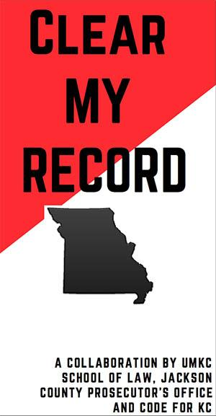

Slide 3
What Does Clear My Record Do?
Offers free access to legal assistance for those who are seeking expungement in Missouri and can’t afford a lawyer
Especially for those who are indigent and modest means
Our website: https://info.umkc.edu/clearmyrecord/getting-started/
End goals:
For people to go to the website and know their eligibility status within a few minutes with or without the assistance of an attorney, and ultimately to obtain the forms necessary to file their petitions from the website.
For those who need the services of a lawyer to obtain expungement to get representation from an Expungement Clinic at UMKC School of Law where faculty and volunteer lawyers assist students to learn how to represent clients seeking expungements while serving those in need.

Slide 4
Short Term Goals for CMR
Process preliminary background checks for as many applicants as possible (approx. 900)
Get back to those who have had a background check done for expungeable offenses, notifying them of the next step
File petitions for those who appear to qualify for expungement and represent them in court where necessary
Gain a deeper understanding of the immensely long and complex expungement statute to process cases more effectively, better assist the legislative process, and make the statute as close to “codable” as possible.

Slide 5
Long Term Goals for CMR
Get as many people expunged as possible from Expungement Day
Our hope is that some of those processed will be eligible for expungement of their entire record and that others who will benefit from a partial expungement can have as much of their records cleared as possible.
Offer people a second chance for a better life
Open up housing and employment benefits
For ex: With certain offenses, you would not be able to get employment in professions where a CDL license is required (teaching, nursing, truck driver, police officer, etc.)
Make record searching and processing more simplified
Have all info compiled in one database

Slide 6
What We Have Accomplished
Legislative Day (9/21)
Met with a panel including members from STL + Jackson County Prosecutor’s Office, NAACP, MO State Senator Kiki Curls, attorneys across the state of MO, and others
Discussed current MO statute, its problems, and ways to mitigate offenses
And how the statute compares to KS expungement laws
Highlights:
Clear impediments to those seeking expungement in MO
We need to make the goal of CMR clearer for the community
And prioritizing certain offenses (like marijuana possession)
Meeting with St Louis County Prosecutor Wesley Bell
Introduction to CMR and plans to expand project to St. Louis area
Working with Case Management System
Working with current statute

Slide 7
Learning the Case Management System
What is it?
Database with information from all expungement-seeking applicants
Process:
Make sure each contact has properly formatted contact name, email address and/or phone number, DOB
Case:
If there’s no case created, we’ll need to go in and create one for them after running background checks
Activities:
Download background documents (Lexis, Casenet, etc.)
Notes:
Any extra important info that may help speed up process
Tags:
We tag important info using key terms that highlight what we need to know for each case

Slide 8
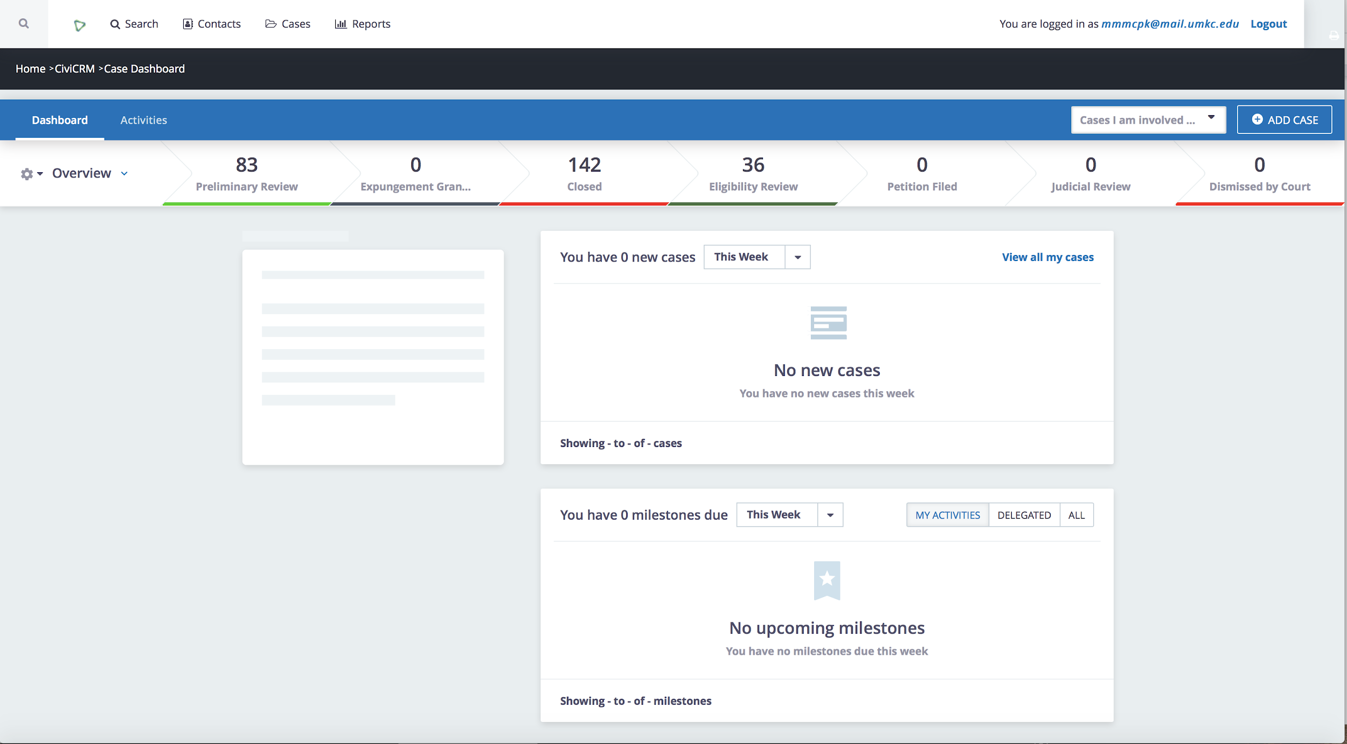

Slide 9
Learning the Statute
It’s complicated, messy and disorganized, so we needed to find a way to effectively break it down
Divided into groups and worked section by section
Created a preliminary flowchart of the info and procedures provided in the statute and necessary in the expungement process
Worked to define the process and stipulations of what it means to go about filing an order of expungement
3 Things to be considered
What NEEDS to be expunged
First by filtering out who cannot be expunged according to the current statute
What CAN be expunged (in Missouri)
What are the potential outcomes
“All” rights restored
Records will remain “confidential”
Disclosure of information

Slide 10
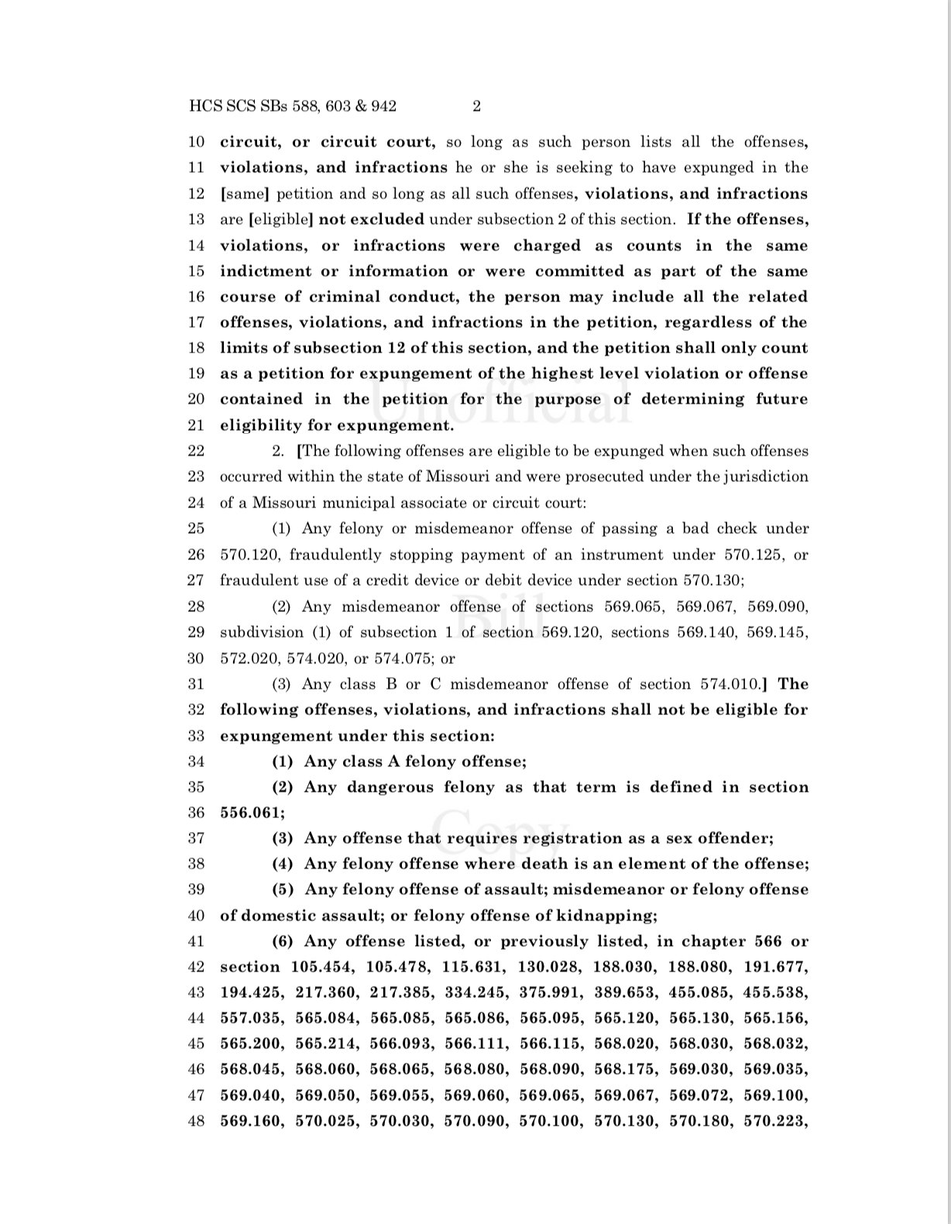
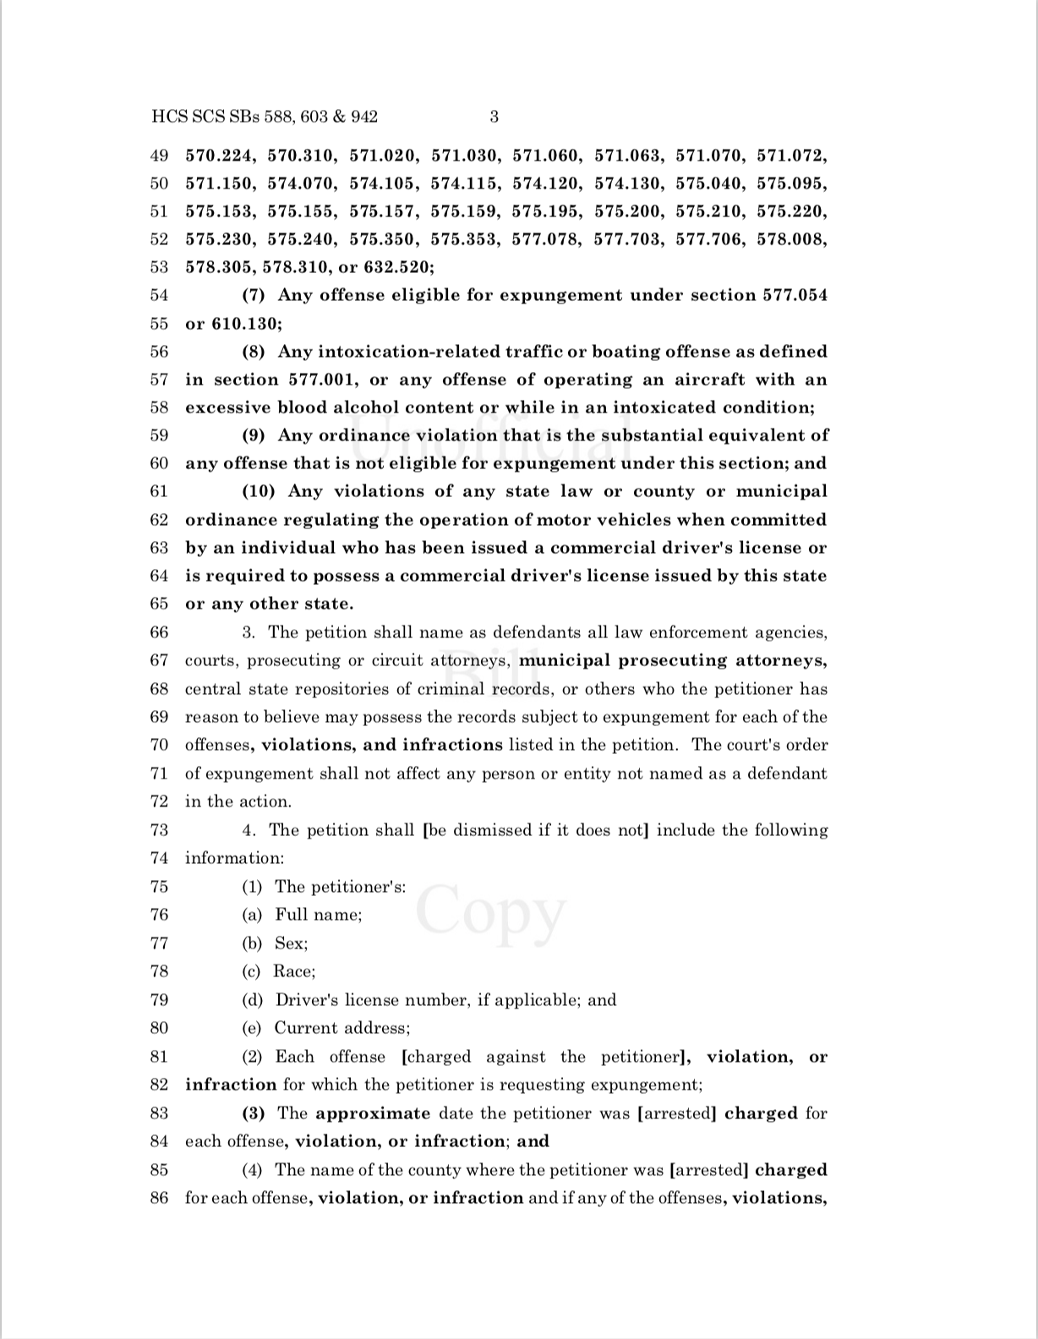
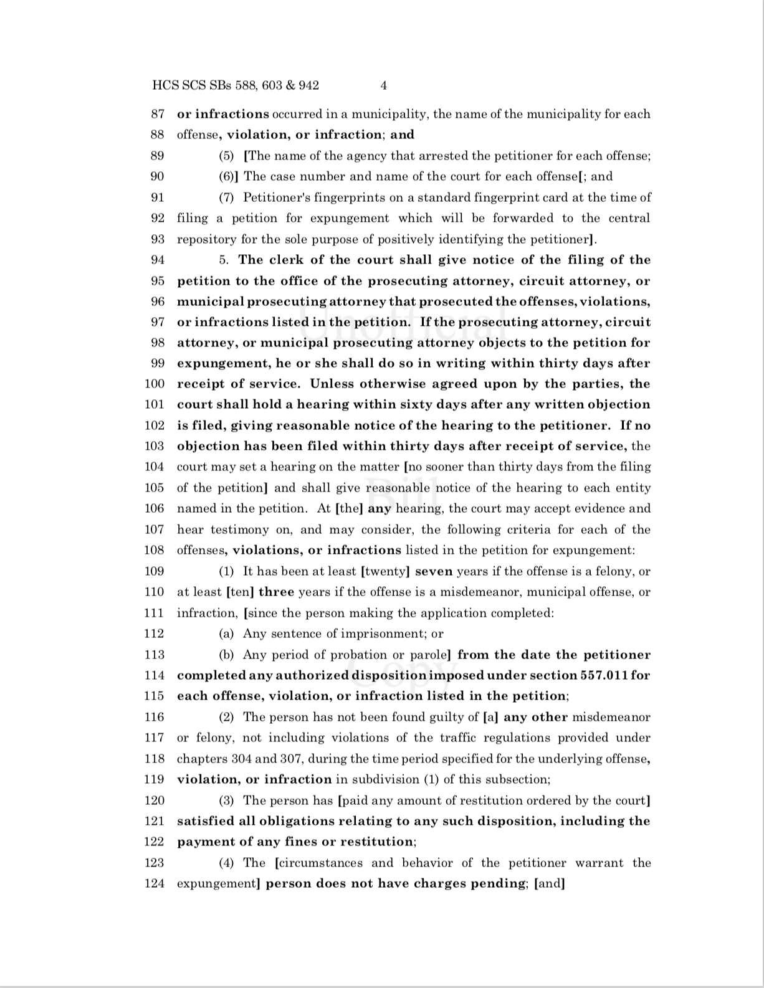
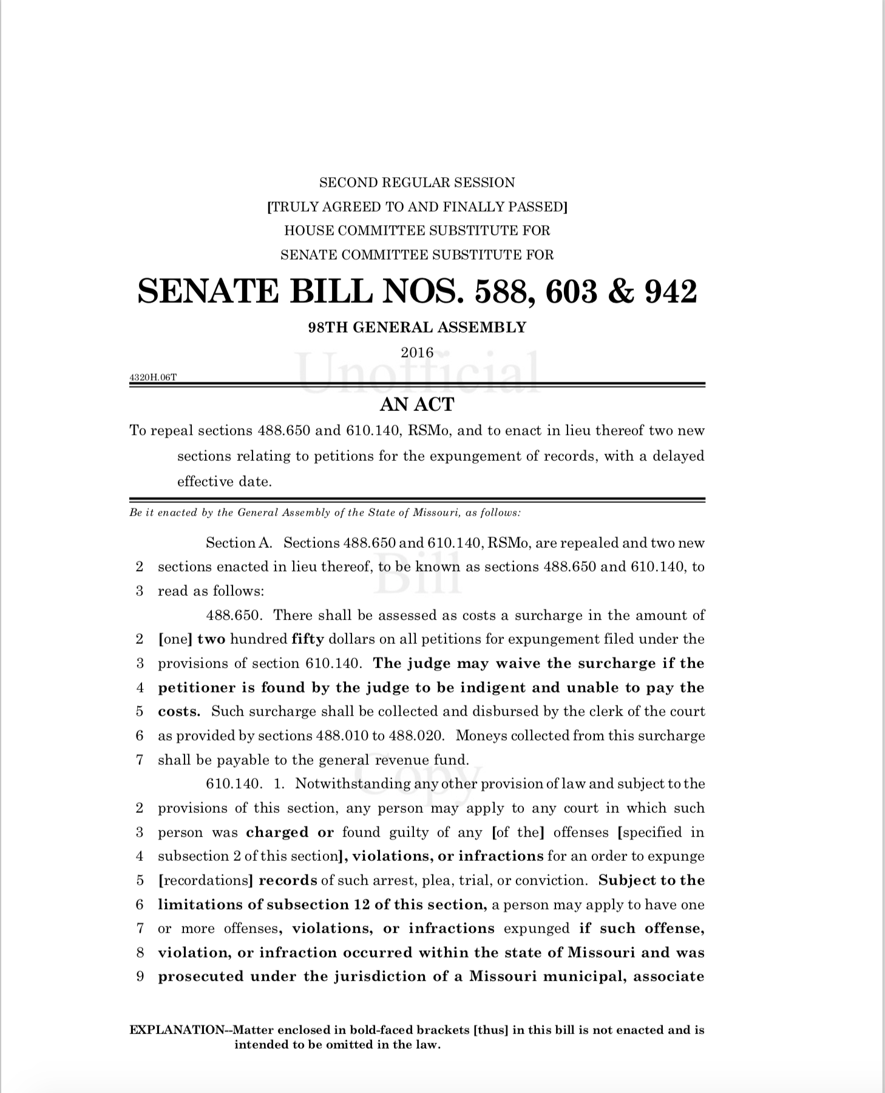
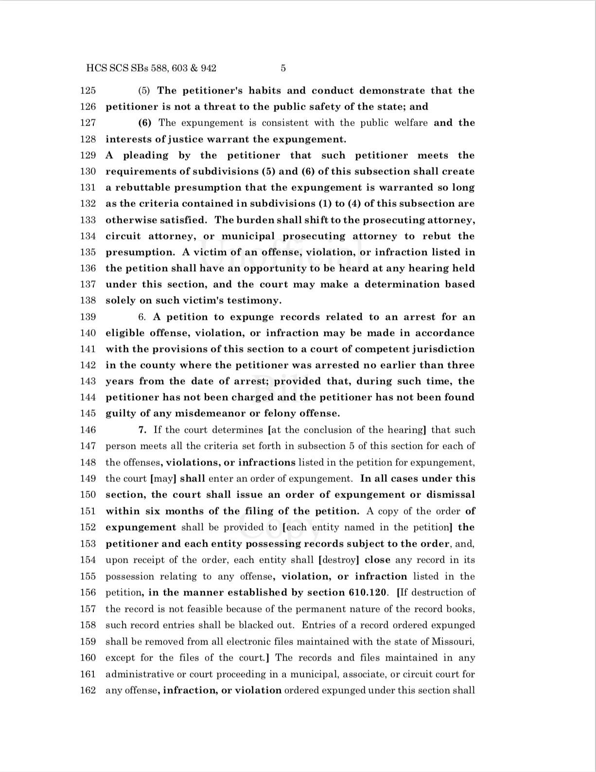
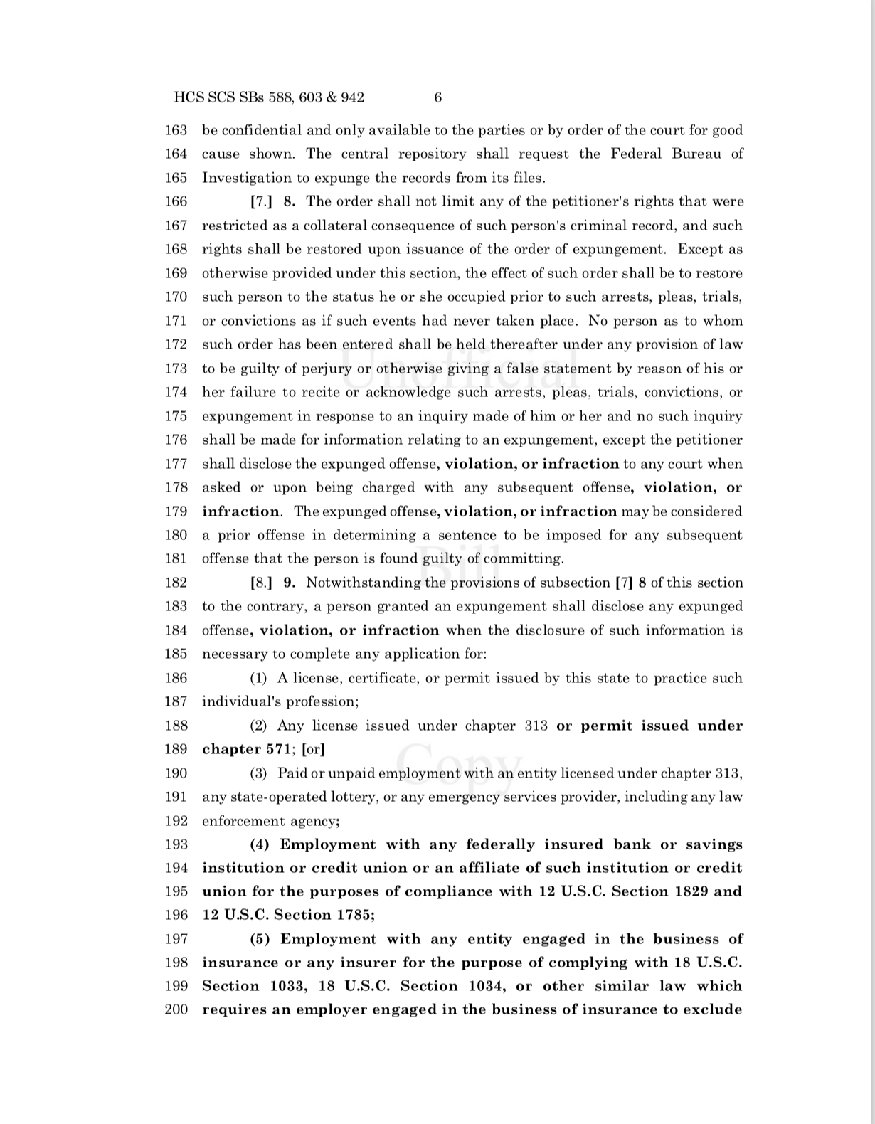
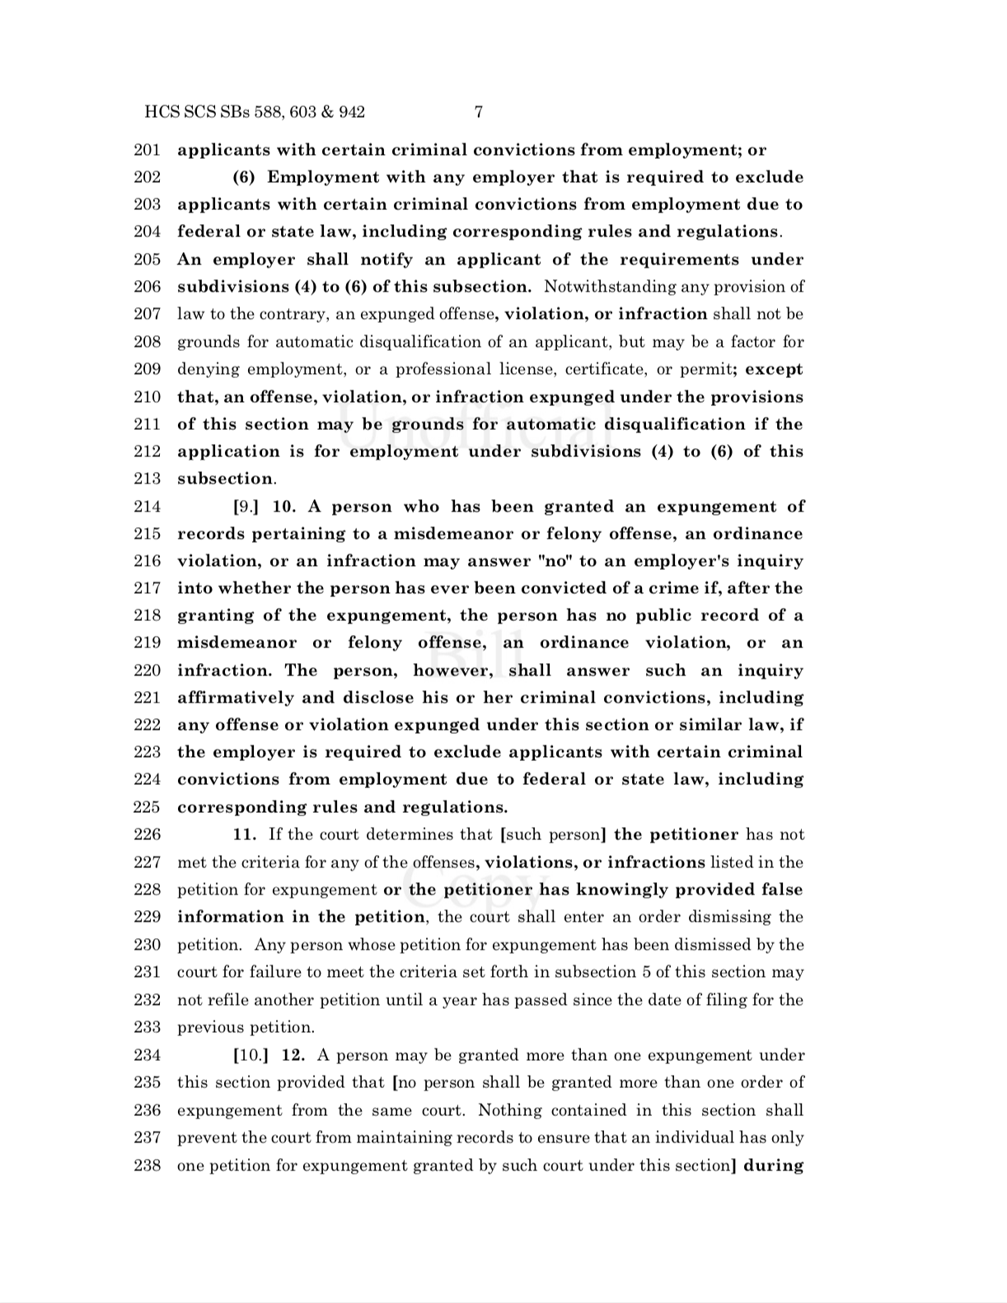
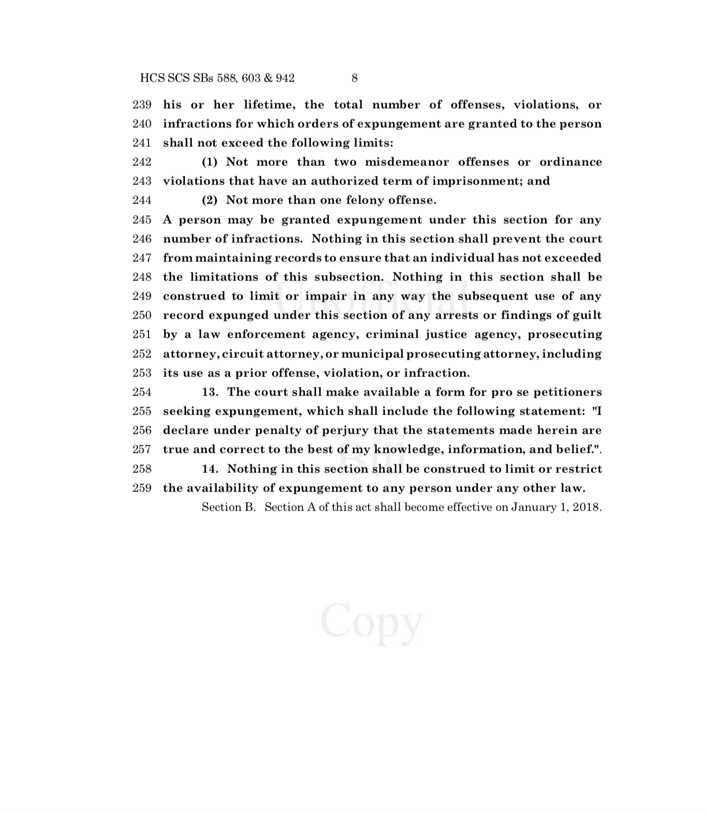
From this...

Slide 11
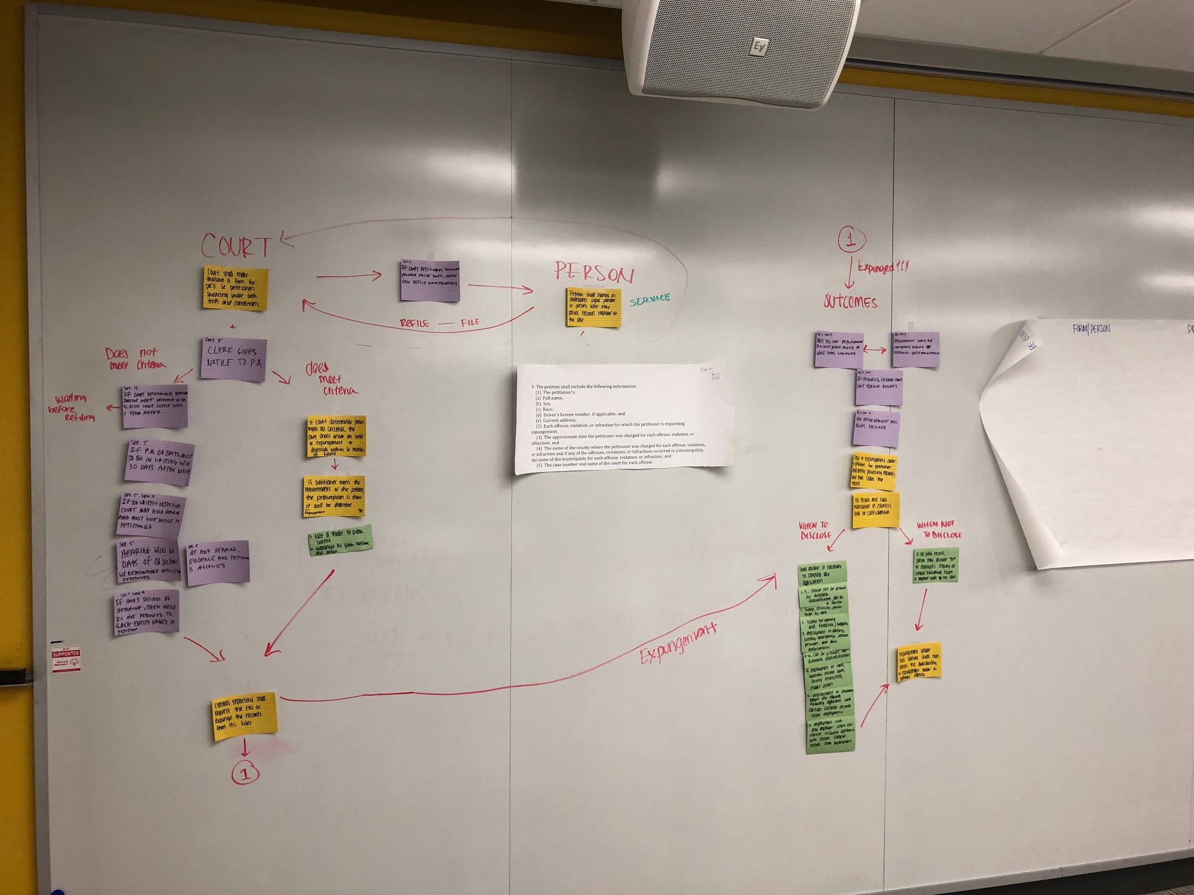
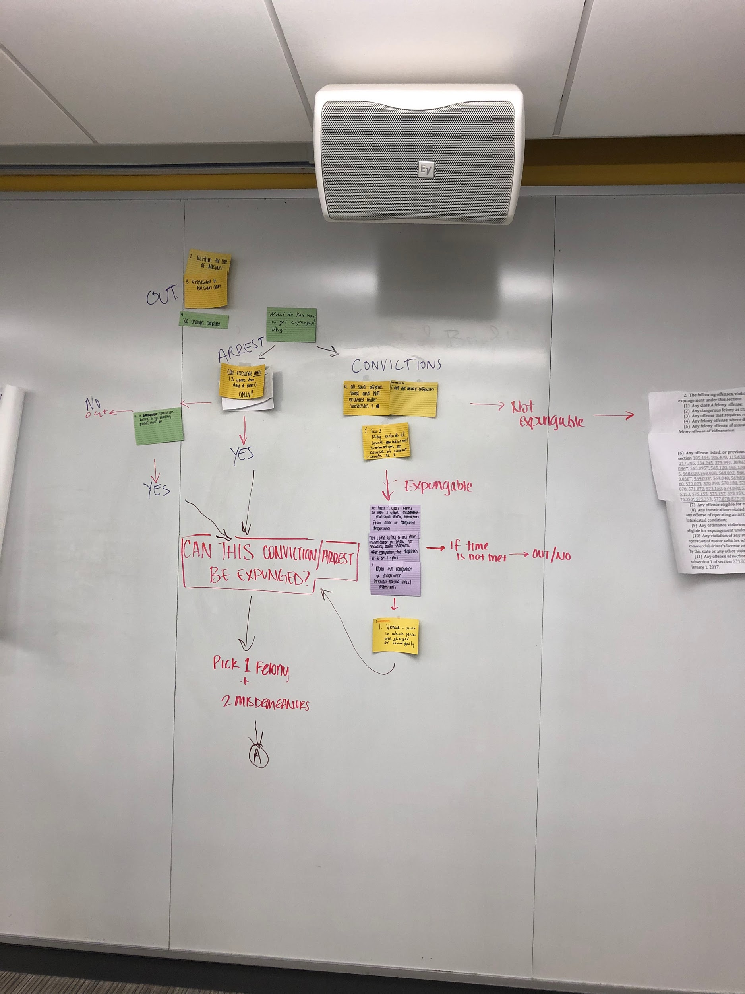
To this:

Slide 12
The Statute, Boiled Down
What on the criminal record CAN be expunged?
1 felony and 2 misdemeanors
Felony after 7 years of completed sentences, misdemeanor after 3 years of completed sentences
Unlimited number of infractions
Eligible 3 years after an arrest if there is no prosecution (and no other offenses)
No other offenses, violations or convictions during this time
Must be:
Within state of MO
Prosecuted in a MO court
Lots of offenses are excluded from expungement (many of which don’t appear to make sense)
A completed sentence with no pending charges

Slide 13
Reflection: What We Learned
All of the factors discussed impact feasibility and effectiveness of CMR project
Data: There are too many systems for recieving info, but the info we receive is limited
No one source contains full and correct record for each client
Statute: Confusing language, lots of layers to dissect
Many loopholes have been made so that convictions are not fully recognized as being expunged
Legislative: Lawmakers are overlooking the short and long-term negative effects caused by the language in the statute
As well as how disorganized the statute is
When changes are made to the statute, we have to go back and reevaluate those who were previously excluded and recheck their eligibility status

